Slide 1
Multifunctional Low-cost Integratable Optical Devices
Guide:
Dr Subramanyan Namboodiri Varanakottu
Alex Shajan – B180649EP
Suryasaradhi.B - B180976EP

Slide 2

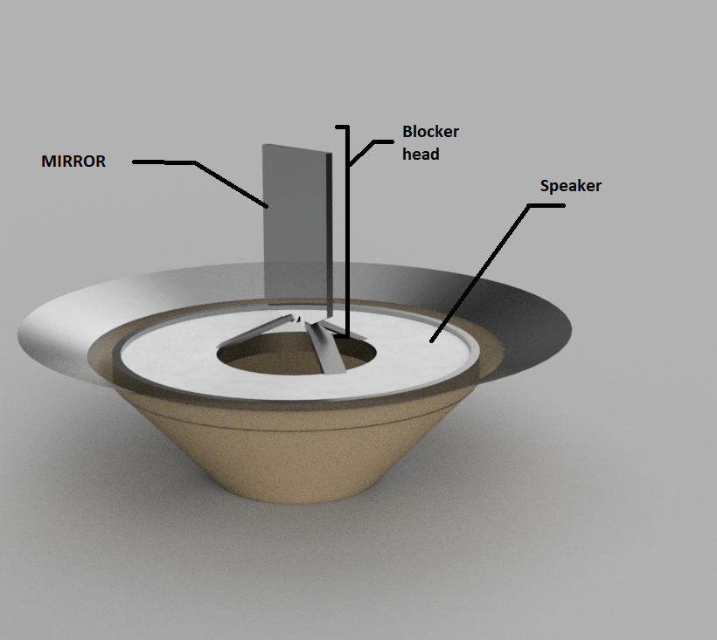
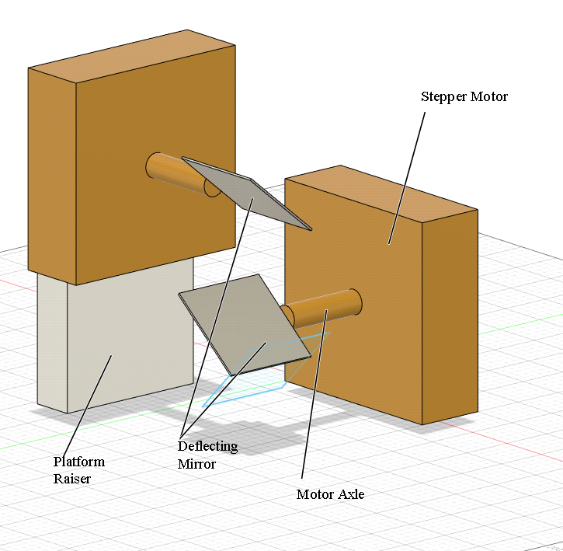
Objectives
Design of “Beam Chopper-Beam Steering” System.
Characterisation of “Beam Chopper-Beam Steering” System
Design level optimization of “Beam Chopper-Beam Steering” System
Creating an Integratable Equipments for LabView allowing easier simulation verification. User Friendly UI having Wireless control for Handsfree automation

Slide 3
SIGNIFICANCE OF THE WORK
There is a monopolistic market scenario that companies like Thorlab has, therefore by Implementing the solution we can flip the tables thereby by making affordable Made in India optical instruments.
Reducing the external disturbances made while adjusting the equipment by making the Equipment Wireless.
The product can be tailored according to the needs of the customer , as the product software will be opensource for the community to work on.
Easily Integratable and Scalability of the devices help users to conduct their experiments and take readings as fast as possible
Introduction of new types of techniques to achieve the same outcome will result in low-cost production methods which should pull down the existing products market price.

Slide 4

Detailed Methodology
For the manufacture of the said devices, we will be using high end 3D printers for printing the base and delicate materials up to nm range precision. Laser Printing may be employed for precision cuts.
The Tensile integrity of the choppers need to be very high to support high frequency chopping ,lightweight materials will be used for printing, PLA would be the first choice of preference to print, followed by resin for transparent surfaces
C++ and python Will be employed to interact with COM object models of LabVIEW as well as the MCU's, PID Loops will help correct errors in the system, increasing its repeatability
Chopping Testing and verification will be done using high speed cameras to measure the tolerance of the instrument.
Beam Steerer's Inertia of stepping angle will be measured while vibration testing the entire apparatus which can be carried out using an accelerometer.

Slide 5
Work Done
Tested and verified authenticity and legibility of bought hardware component against their datasheets.
Practical experiments to find hardware constraints and maximum specifications reachable on desk.
Created fabrication ready PCB layout and 3d Printable models and Applied for PCB Fabrication services And Started 3D Printing device housings.
Finished the server stack on ESP12S , Writing down the frontend for the IOT base.
Stress Test Device with Consumers

Slide 6
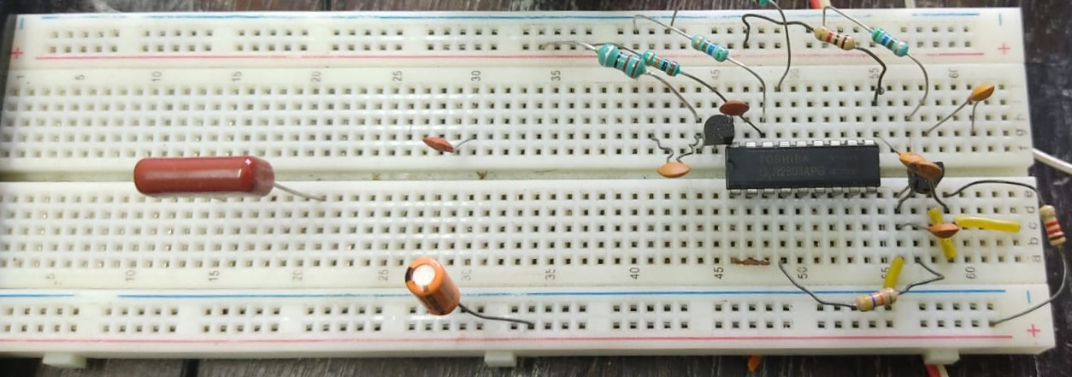
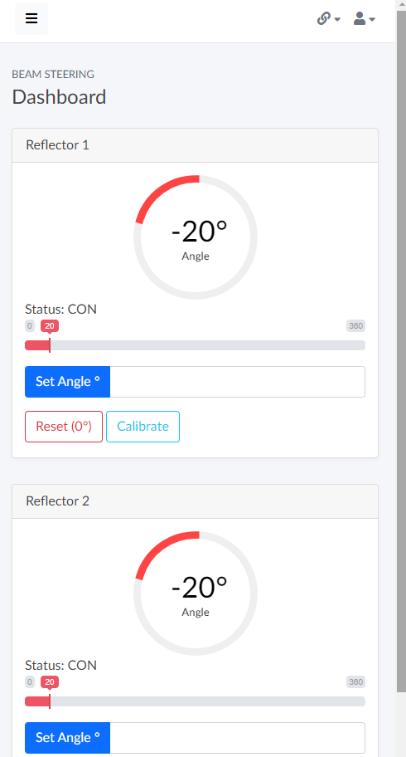
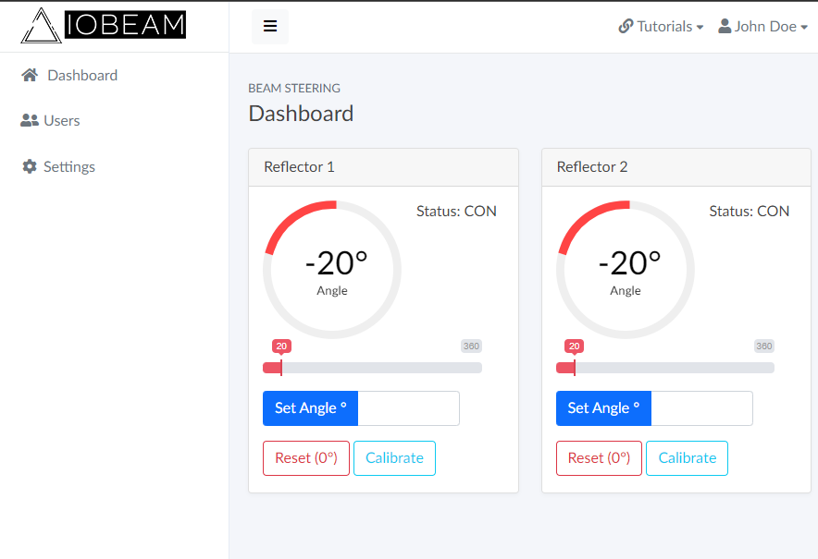
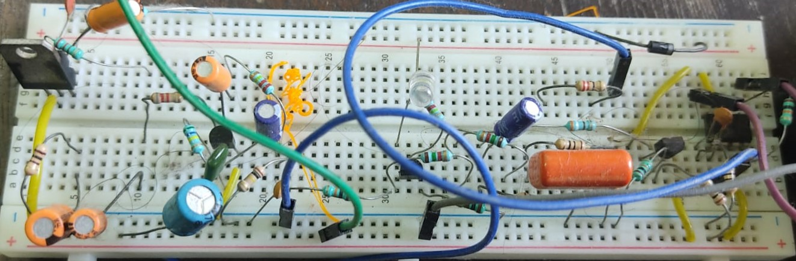
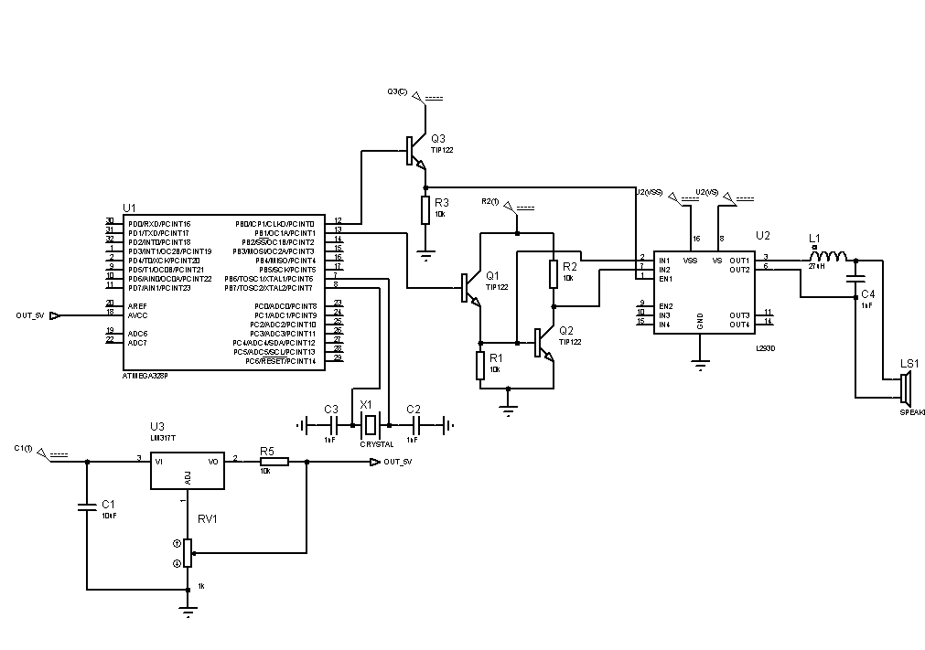
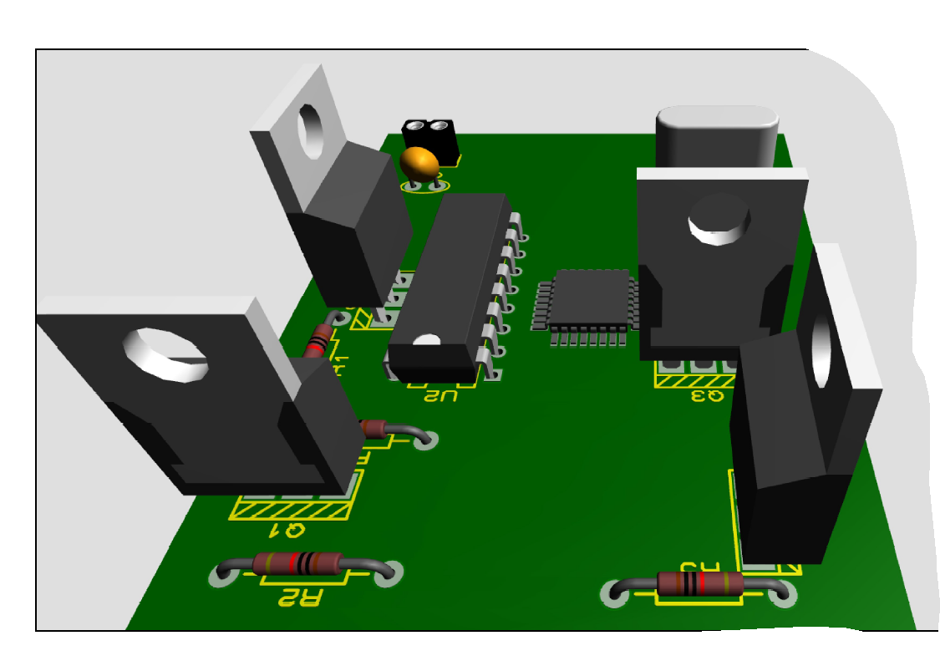
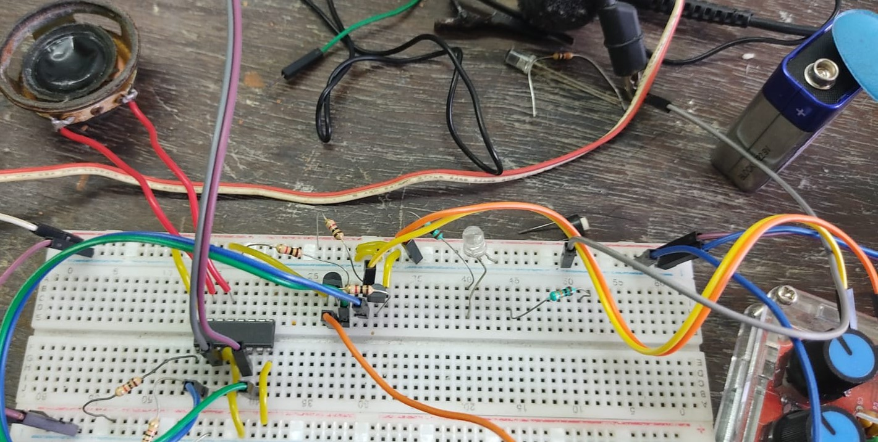
Work Done
H BRIDGE TEST:
IOT BASE
OLED Screen Test:
:PCB SCHEMATICS
SPEAKER FREQ-TEST:

Slide 7
OUTCOMES ACHIEVED
Market Study and Product upgradation.
Simulation of Electronic Components.
Software stack in production.
Submission for Fabrication of PCB and Housings.

Slide 8
FUTURE WORK PLAN
Acquire the fabricated PCB, Assemble and test the outcomes.
Stress test 3-D Printed housings
Check IOT base on various devices with varying resolution.
Stress test finished product.

Slide 9
EXPECTED OUTCOMES
Manufacture of Low-cost multifunctional Optical instrument includes :
Beam- Chopper
X-Y Beam Steering
Integrating the instrument to LabVIEW and other instruments for real-time analysis.
Due to the aspect of using new methods of linear chopping ,Filing and publishing of patent/prototype application based on the proposed innovation is possible.
Complete Software Stack for Windows ,Linux and Android with wireless controls.

Slide 10
BUDGET ALLOCATION STATUS
TOTAL AMOUNT ALLOCATED | AMOUNT UTILIZED | REMAINING AMOUNT
 | 5000

Slide 11
THANK YOU!

Slide 12
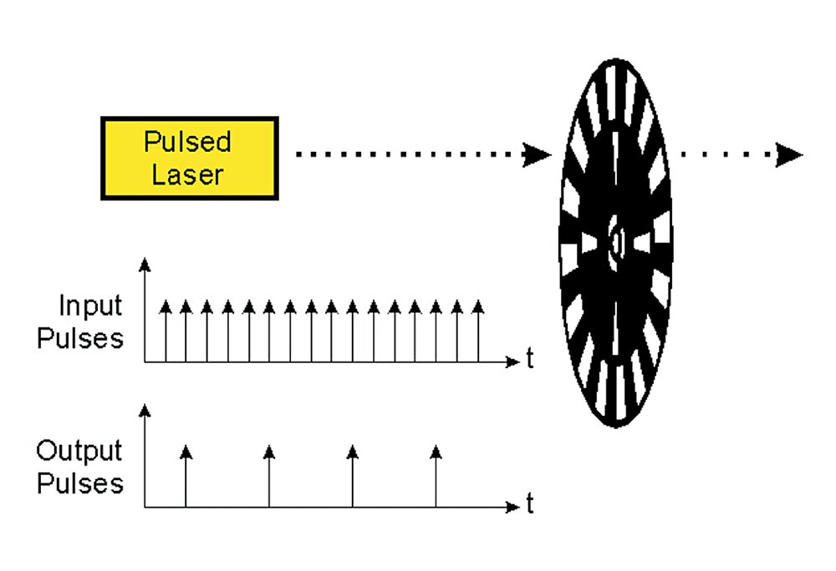
BEAM CHOPPER
An Optomechanical device which periodically interrupts a light beam.
Conventional Beam Choppers:
Rotating disc Chopper
Tuning Fork Choppers
Optical Shutters
Modulate the intensity of light beam
They have various labortical and real life applications.

Slide 13
BEAM STEERER
A Beam steering is about changing the direction of the laser beam and projecting it on a desired point in the screen.
The model comprises of two mirrors connected to steppers and project the beam to a necessary point on the x-y plane.

Slide 14
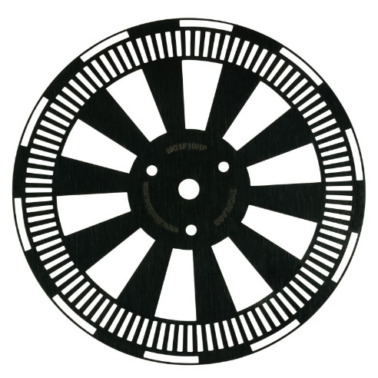
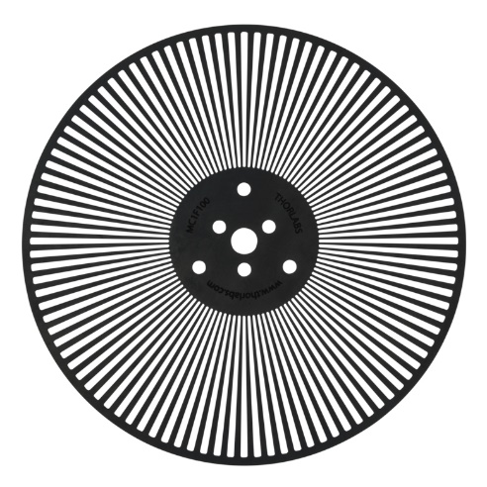
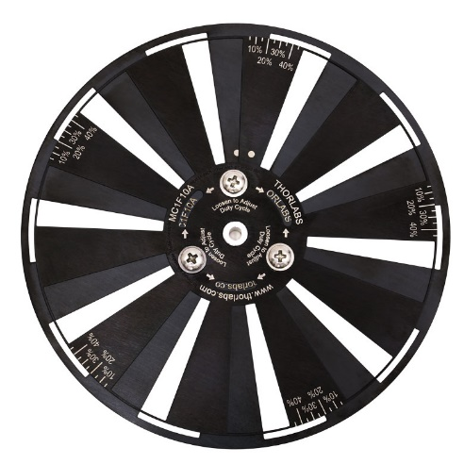
Market Study (Beam chopper)
Zurich Instruments
Up to 1KHz
May cost over $1000 + shipping
Using disc model
Edmund Optics
Up to 20kHz
May cost up to $1,375
Disc based chopper
ThorLabs
Up to 10kHz
May cost over $1000 + shipping
Have a combination of 6 discs

Slide 15
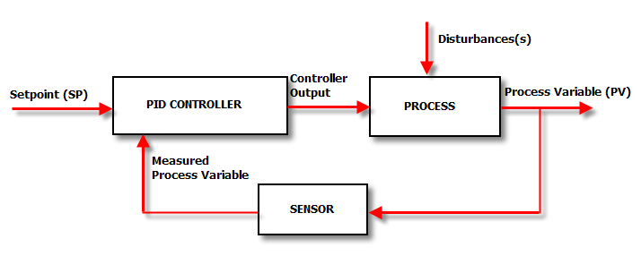
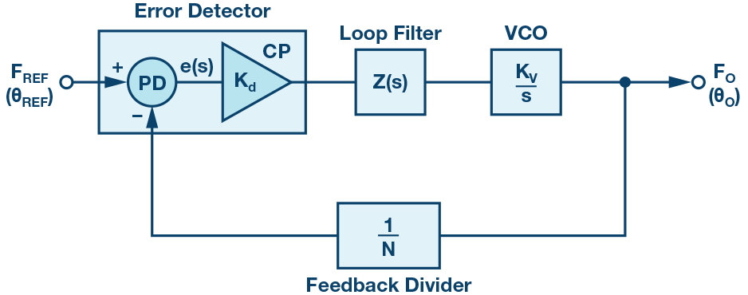
PLL Source follower
A custom source can be fed in and can be made to follow. It is capable of locking onto the source and following it. In this project, the PLL of choice to be used is CD4046.
PID Control loop
Most of the components in real life go out of sync. So PID control loop is used as feedback to control them. It uses a close-loop control feedback to keep the actual output close to the target or setpoint.

Slide 16

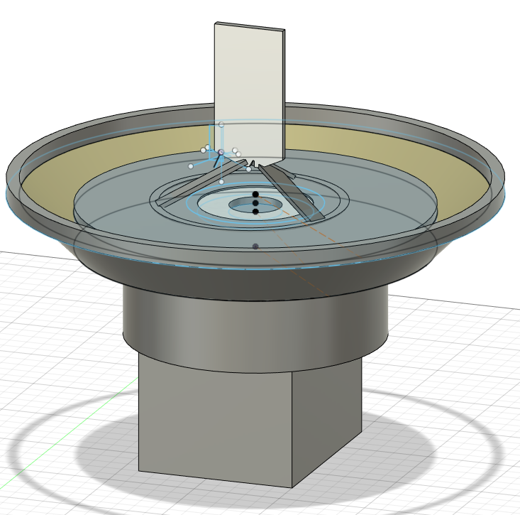
Innovation Aspect
The Chopper will be made of new patentable diaphragm based technique, we are deploying diaphragm based chopping action where instead of rotation chopping is done linearly , this opens up the possibilities of:
Variable Pulse Width
Now lower Limit to frequency
Good Repeatability
Larger Frequency Coverage of chopping
The beam Steerer used will made in contrast with precision of steering rather than speed of steering, for this reduction gears will be applied to stepper drivers (planetary gear boxes)
The devices will be made pluggable to each other (like LEGO blocks) thus aiding the ease of connecting them together if needed (portability improvement)
No need to change discs to get more sensitivity ,as there are no discs
The existing products in the markets needs human interventions to take readings or to adjust the settings, which may tamper with the experiments setup leading to inaccurate results therefore a Fully automated wireless control will help in handsfree uninterrupted operation of the products
The products will be made integratable with LabView so that users can compare the simulation analysis data with Realtime experimental evidences, The User friendly UI controllable via WIFI will help the consumers control the product from any smart devices available to them
Old method used chopping discs
New method without discs

Slide 17
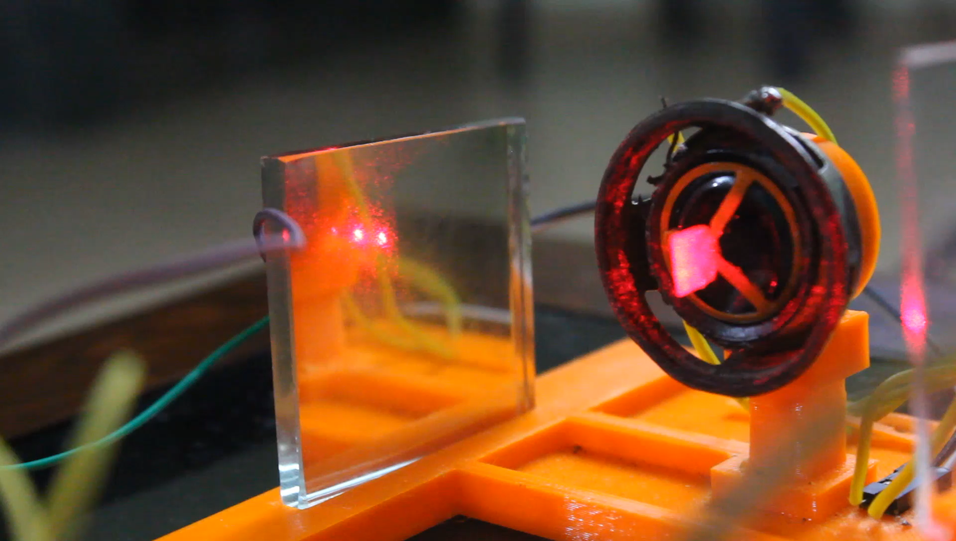
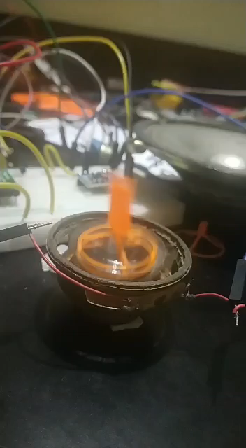
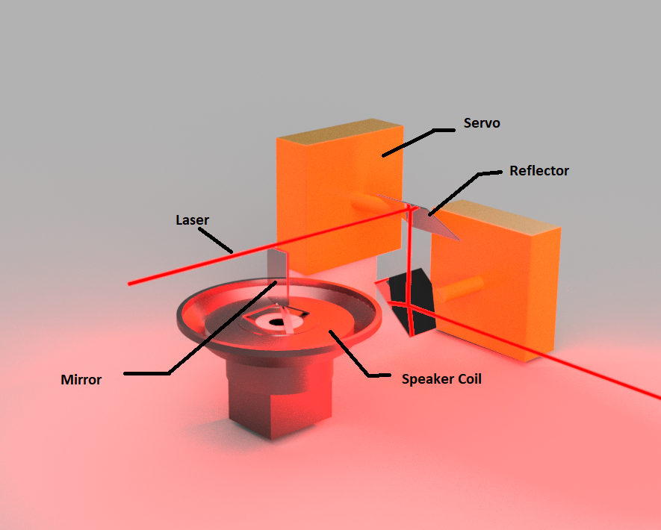
Working Principle & Status Quo
Working of modulator
Modulation in Realtime
The Chopper Consists of a diaphragm moving up and down , on the head of the diaphragm a mirror or a blockhead is connected ,the block head moves up and down chopping the beam as shown in the video.
The Beam Steering is a simple device consisting of two steppers having two mirrors aligned at 45 degrees with each other in perpendicular planes, By rotating the mirrors around we can scan the output laser beam across the screen.
We have developed a working proof of concept of our diaphragm based chopping system which we used for communication with a frequency of 1khz.This Frequency can be increased in later stages.
Labview Integration is in COM (Component Object Model) connection state. Circuits were simulated in Proteus and prototyped on breadboards.
OPTICAL CIRCUIT

Slide 18
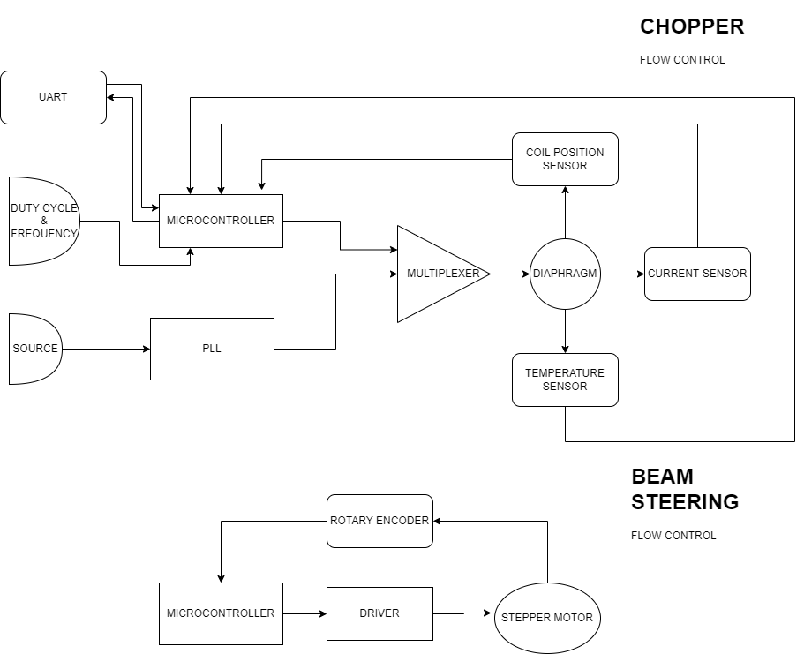
HARDWARE FLOW & SIMULATION
FLOW CONTROL:
CIRCUIT SIMULATION:
PCB
DESIGN:

Slide 19
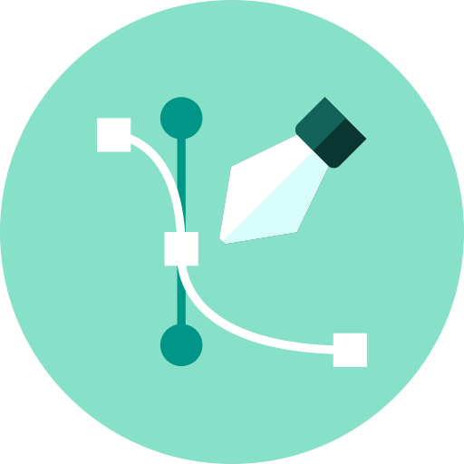
Design Aspects (Chopper)
 | Revision 1 | Revision 2 | Revision 3
Max Chopping Frequency | 4kHz | 10kHz | 20kHz
Min Chopping Frequency | None | None | None
Max Frequency Tolerance | 5% | 1% | 1%
PWM | YES | YES | YES
Temperature Drift | 0.1Hz/C | 0.01Hz/C | 0.01Hz/C
Max Beam Diameter | 5mm | 1cm | 1cm
Chopping Resolution | 0.1Hz | 0.01Hz | 0.001Hz
PLL Refrence Chopping | NO | NO | YES
Phase Control | YES | YES | YES
Wireless | NO | YES | YES

Slide 20
Design Aspects (Beam Steering)
 | Revision 1 | Revision 2 | Revision 3
Min Stride Angle (Without Reduction) | 10deg | 8deg | 5deg
Min Stride Angle (With Reduction) | 4deg | 1deg | 0.15deg
Gear Reduction | 1/16 | 1/32 | 1/32
Gear Type | Planetary | Planetary | Planetary
RPM | 0.1rps | 0.015rps | 0.015rps
Max Beam Diameter | 1cm | 1cm | 1cm
Wireless | NO | YES | YES
Software (Supporting greber) | YES | YES | YES

Slide 21

Expected Outcomes
Manufacture of Low-cost multifunctional Optical instrument includes :
Beam- Chopper
X-Y Beam Steering
Integrating the instrument to LabVIEW and other instruments for real-time analysis.
Due to the aspect of using new methods of linear chopping ,Filing and publishing of patent/prototype application based on the proposed innovation is possible.
Complete Software Stack for Windows ,Linux and Android with wireless controls.

Slide 22
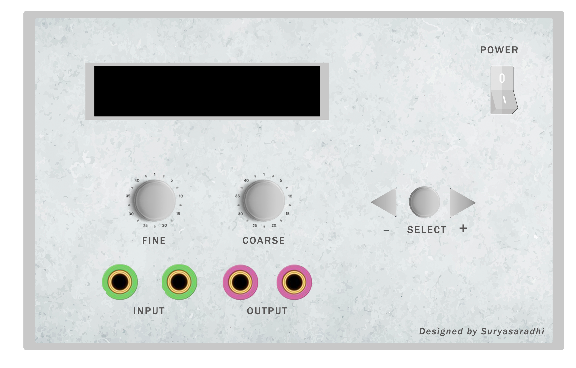
Frequency Controller Device

Slide 23
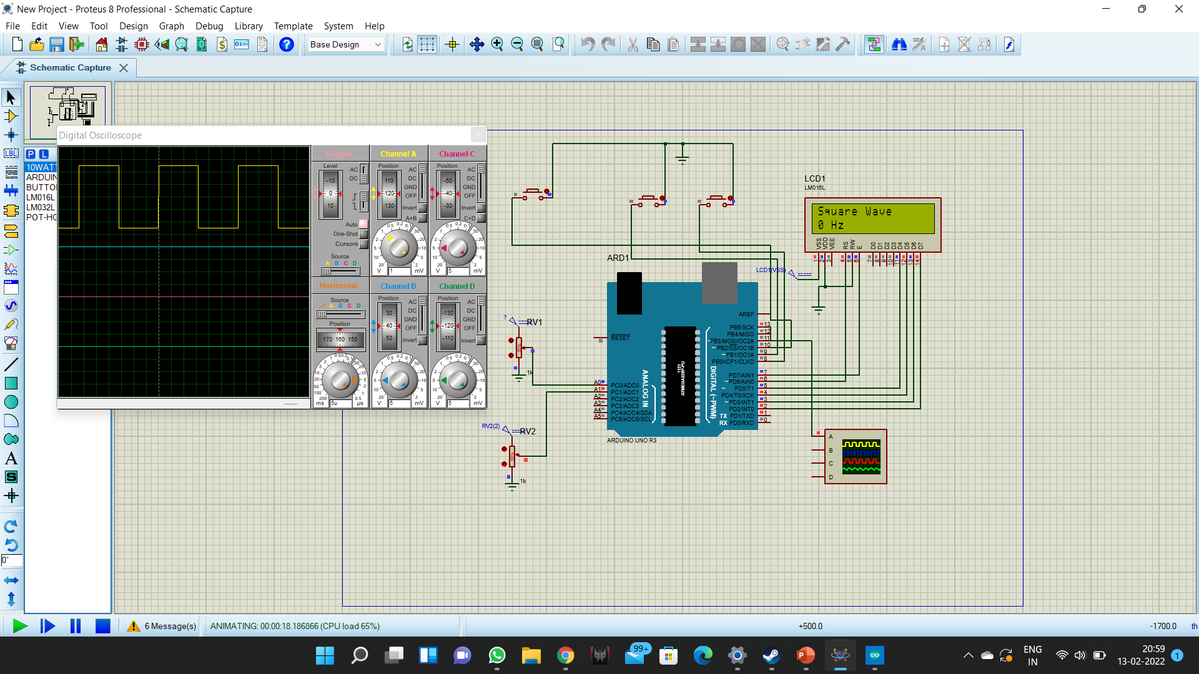

Slide 24
FREQUENCY CONTROLLER
void loop()
{
for(int i = 0;i<2;i++)
{
if (buttonpressed(i))
{
changescreen(i);
displaylcd();
}
}
if (potentio_change())
displaylcd();
if (buttonpressed(2))
{
noTone(13);
tone(13,init_potential);
}
}
bool potentio_change()
{
int temp = analogRead(A0);
if (temp != init_potential)
{
init_potential = temp;
return true;
}
return false;
}
#include <LiquidCrystal.h>
LiquidCrystal lcd(6, 7, 5, 4, 3, 2);
int inputpins[] = {8,9, 10};
String screens[3][2] = {{"PLL Follower","Volts"}, {"Square Wave", "Hz"}, {"Sine Wave","Hz"}};
bool initial[] = {LOW, LOW, LOW};
int screen_number=0;
int init_potential =512;
void setup()
{
for(int i = 0;i<3;i++)
pinMode(inputpins[i], INPUT);
lcd.begin(16, 2);
Serial.begin(9600);
}

Slide 25
bool buttonpressed(int i)
{
if (digitalRead(inputpins[i]) != initial[i])
{
initial[i] = digitalRead(inputpins[i]);
if (digitalRead(inputpins[i])==HIGH)
return true;
}
return false;
}
void changescreen(int i)
{
if (i==0)
{
if (screen_number ==2)
{
screen_number =0;
}
else
screen_number++;
}
else
{
if (screen_number ==0)
{
screen_number =2;
}
else
screen_number--;
}
}
void displaylcd()
{
lcd.clear();
lcd.print(screens[screen_number][0]);
lcd.setCursor(0,1);
lcd.print(init_potential);
lcd.print(" ");
lcd.print(screens[screen_number][1]);
}

Slide 26
PID CONTROL LOOP
void setup()
{
//initialize the variables we're linked to
Input = analogRead(PIN_INPUT);
Setpoint = 100;
//turn the PID on
myPID.SetMode(AUTOMATIC);
}
void loop()
{
Input = analogRead(PIN_INPUT);
myPID.Compute();
analogWrite(PIN_OUTPUT, Output);
}
#include <PID_v1.h>
#define PIN_INPUT 0
#define PIN_OUTPUT 3
//Define Variables we'll be connecting to
double Setpoint, Input, Output;
//Specify the links and initial tuning parameters
double Kp=2, Ki=5, Kd=1;
PID myPID(&Input, &Output, &Setpoint, Kp, Ki, Kd, DIRECT);

